Slide 1
AYSO Region 76
12U Coaching Course – 2019
Michael Karlin

Slide 2
Agenda
Classroom – 9:00 to 11:45 am
AYSO Fundamentals
Team Management
Teaching Methods and the Coaching Cycle
Objective and Principles of the Game
Systems of Play
Laws of the Game
Test
Wrap up

Slide 3
Contact Information
Regional Commissioner – Alex Grossman commissioner@ayso76.org
Coach Administrators – Ji Lee and Jeff Gross coach@ayso76.org
Webmaster – Michael Karlin webmaster@ayso76.org
Website Coordinator and Boys 12U Division Director – Gil Bar-Zion – bu12@ayso76.org
Girls 12U Division Director – Gary Dyner – gu12@ayso76.org
Our website:
Public: www.ayso76.org
Password protected: www.ayso76.net

Slide 4
AYSO Fundamentals
Vision Statement: To provide world class youth soccer programs that enrich children’s lives
Mission Statement: To develop and deliver quality youth soccer programs, which promote a fun, family environment based on our philosophies
AYSO Six Philosophies
Everyone Plays – 2 and 3 quarter rule – we mean it!
Open Registration – we take everyone
Balanced Teams – no requests or player retention
Positive Coaching – be nice
Good Sportsmanship – teach the players to be nice
Player Development – improve players skills

Slide 5
Local Philosophies
The primary goal of our coaching program is player development
Defined as the improvement of all players’ individual and team skills to their maximum potential
The program must meet the desire of players and their families for recreation that is safe, fun and educational
IT’S NOT ABOUT WINNING! IT’S ABOUT TEACHING!
The program must also be rewarding for coaches.
Coaches are volunteers, many with limited experience as educators and with the game of soccer
To help them, we will provide and, in some cases, mandate the use of a wide variety of additional training and resources

Slide 6
Web Systems
ayso76.net – Regional Program developed by inLeague, our web developer for many years
Our entire program is administered using this system
This now includes volunteer registration
Full instructions on the volunteer process are at https://www.ayso76.org/coaches/coach-certification/
It is a three-part process, beginning within logging in to www.ayso76.net and going to Player and Volunteer Registration (first item on the Quick Links navigation bar)
Next, you will undergo a background check by Sterling Volunteers, an outside organization retained by AYSO – you will receive an email invitation
Finally, you have to undergo training, part of which is online
aysou.org –training resources, including the 12U Pre-Course, Concussion Awareness and Safe Haven

Slide 7
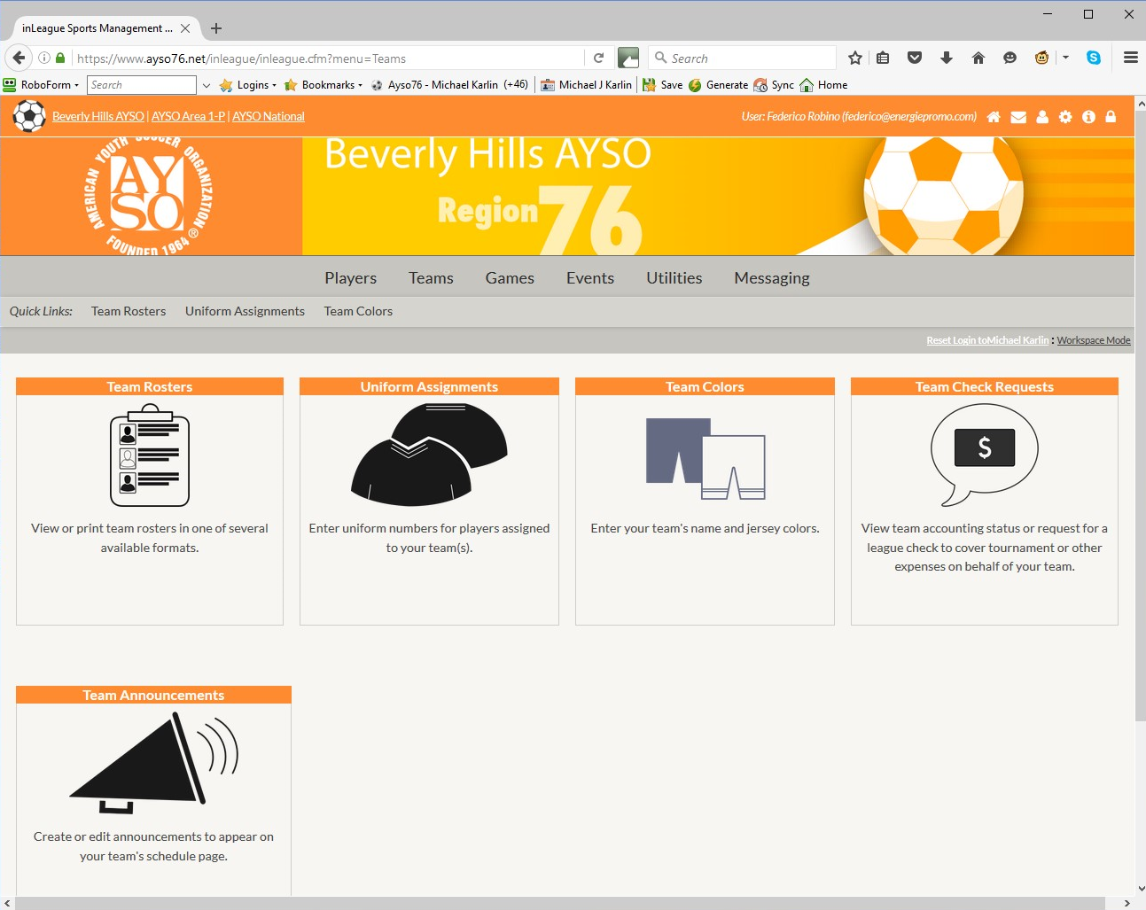
inLeague (ayso76.net)

Slide 8
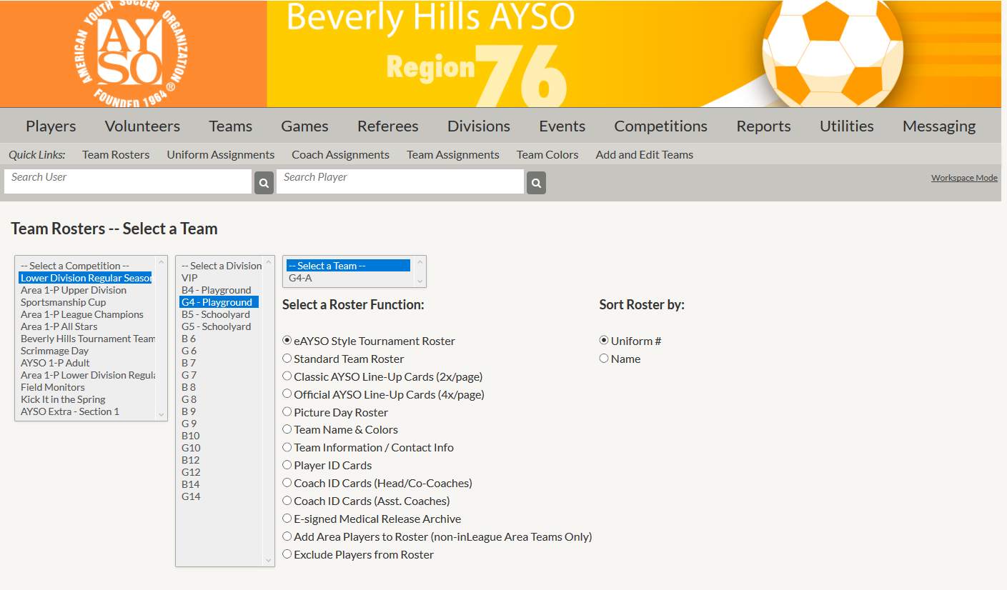
inLeague (ayso76.net)

Slide 9
Before We Begin
“Failing to prepare is preparing to fail.”
John Wooden

Slide 10
Team Management
Organizing the Team
Roster and other web resources
Parent meeting and appointing a team administrator
You can now do this
Medical releases and Kid Zone Pledges
A player cannot practice or play unless the coach is in possession of a signed medical release
Equipment
Balls – size 4 for 10U and 12U (have a size 5 for yourself)
Cones – flat
Practice vests – 7 x 2 colors
First aid supplies (see below)
Deck chair
Practices and build-up
Game day preparation

Slide 11
The Team Meeting
Set the team goal
Make it a pool party for the kids
When talking to the parents:
Briefly mention AYSO’s vision, mission and philosophies
Explain your coaching philosophy and expectations (punctuality, communication, equipment, etc.)
Introduce Player and Parent Pledges
Introduce Kids Zone for a positive sideline
Discuss team goal
Encourage communication regarding any player injuries
Discuss concussion awareness, Safe Haven, etc.
Recruit team parents

Slide 12
Training Management
Prepare your practice before you get to the field
Have a lesson plan – you are a teacher and the field is your classroom
Be sure there is a ball for each player
Players bring one each or you bring them
Training uniforms (white t-shirt, black shorts) promotes team spirit
You have just one hour
Arrive early and appropriately dressed
Require players to arrive 15 minutes before official start time, so they can put on cleats and get ready
Work with assistants to mark out spaces with flat cones
Warm up on the sideline if you can
Hydration is vital:
Short, disciplined breaks, especially early in season
Water not sweetened drinks so players take more fluid

Slide 13
Training Management – The Lesson Plan
You don’t have to make it up
Many training plans are in the Online Manual (last item in your 12U Online Course in aysou.org)
Use the links in the pdf to see animated versions of drills
Visit http://www.ayso76.org/Coach/coach-resources.cfm (we will be updating this soon)
Organization of a coaching session
Sideline warm-up (don’t wait for the field to be yours!)
Technical warm-up
Activities – two or three at the most
Small-sided match
Don’t run laps –do activities with a ball
Don’t give lectures!

Slide 14
Training Management
Practices should be planned into 5 segments:
Warm-up (at least 80% free play with the ball) – 5-10 minutes; use dynamic not static stretches
One or two skill drills – 20 minutes
A scrimmage or game – 15-20 minutes
A second drill at the end – 5-7 minutes
Cool down run and stretch after practice, not before
You don’t have to make it up. Several curricula for 12U are available (see last slide)
All activities should involve frequent touches – NO STANDING IN LONG LINES – for a shooting drill without lines, see the Appendix
If it doesn’t work, stop. Do something else.
Use the Coaching Cycle and concept of Build-up
Notes:
Static stretching involves stretching movements performed at gradually
increased speed. False

Slide 15
Age Appropriate Training
Training/sessions must be adapted to the player’s specific age and stage of development – at this age especially, players of the same age may have wide variations in development and maturity
Four key components should be considered and woven through each session; however, at all-times with deep respect to the player’s specific age and stage of development

Slide 16
Psychosocial
12U Players:
In between childhood and adolescence, 12U players are ready to learn
Can process more abstract thought and handle more complex tasks
More analytical which boost their tactical awareness and understanding
Early or late puberty can impact self-esteem and relationships.

Slide 17
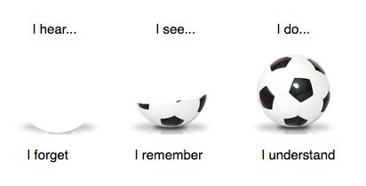
Teaching Methods
P.I.E. (Positive Instruction & Encouragement)
Coaching Sandwich: A slice of critique inside two slices of praise
Say, Show, Do and Review (explain, demonstrate, have them do it, observe (silently) and correct)
See, Show, Say Method (watch, show them what needs to be corrected or improved, and then critique)

Slide 18
Additional Thoughts on Teaching
Keep your words short and simple
KNEEL and SQUAT – your players are smaller than you and when you talk to them, you should try to avoid looking down on them
If you can, demonstrate; if you cannot, get help
Treat your own child like other players – don’t expect more (or less) from them; don’t focus only on them; praise them; when the session or game is over, talk about something else on the drive home
DON’T TREAT YOUR PLAYERS LIKE PIECES IN A GAME OF SPEED CHESS
DON’T CRITICIZE WHAT JUST HAPPENED – THE GAME HAS MOVED ON
DON’T YELL

Slide 19
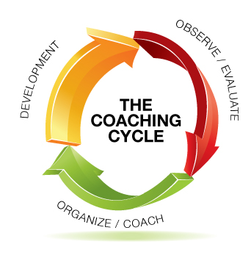
The Coaching Cycle
Coaching involves OBSERVING and EVALUATING player and team performance to determine what needs to be worked on (ORGANIZING and COACHING) during training in order to maximize (Player and Team) DEVELOPMENT
Training components (psychosocial physical, technical, tactical) are then incorporated into a training session (plan) to develop and improve the player’s competence in match conditions

Slide 20
The Coaching Cycle
ORGANIZE/COACH: Training is comprised of: (free play); warm-up; activities I & II; small-sided matches and cool-down
Principles of Play should be considered and woven throughout the session
Adjusting Speed, Space, Opposition controls the intensity of an activity
Coach using sound methodology (P.I.E., Say, Show, Do, Review, etc.) to increase success and develop players
DEVELOPMENT: Player’s improved competence within match environment (finishing; short/long play; short combined with long play; ability to keep possession; risk; transition)
OBSERVE and EVALUATE performance and select elements for the next training session

Slide 21
Build-Up
Learn the concept of build-up
Start with no pressure – time or space
Limited pressure – reduce time or space; add opponent(s)
Full pressure – players involved in game-like situations
Game conditions – game with rules designed to emphasize what you want to teach – small-sided games are the best way to do this
Give time to weaker players – how well you coach them will determine your team’s success

Slide 22
One Topic Per Session
Focus on one topic per session
Resist the temptation to coach skills or correct mistakes that are unrelated to the topic of your session
Repetition is the key to developing skills – more than you might expect, the players often have a lot of patience with repeating the same drill until they get it right
For those that get it right away, vary the drill to make it more difficult (e.g., work with the weaker foot)

Slide 23
Scrimmages and Games
Don’t just scrimmage. Scrimmages should be tuned to the practice theme. For example:
To teach offence:
Use unbalanced teams
Shorten the field to eliminate transition
To teach passing:
Use Hands Game
Alley Game - create a field with cone-demarcated passing lanes
Coaches:
Play only if you know what you’re doing
Don’t show off and don’t score
BE CAREFUL –players are 1/3rd to ½ of your weight
Scrimmage in mid-session, not the end, so players don’t spend all practice waiting for it to begin

Slide 24
Technique and Tactics
Soccer is an individual sport and a team game
Before the age of 12, the primary emphasis has to be on individual technique:
Bringing the ball under control
Moving with the ball
Kicking the ball accurately and at the right pace
One on one play
Team tactics become more important as players get older – but understand that the key to tactical success, spatial awareness, develops over time and is not fully developed at 11 years old
12U is primarily about “Technical Cleansing”
Notes:
Primarily cover techniques in the field sessions.

Slide 25
Training Overview for U-12 Players
U-12 Techniques | U-12 Knowledge
Dribbling | Know the 8 restarts
Inside of foot – ball control | Corner kick
Sole of foot – ball control | Goal kick
Top of the thigh – ball control | Penalty kick
Instep kick | Drop ball
Inside of the foot – push pass | Direct free kick
Throw-in | Indirect free kick
Tackling | Throw-in
Goalkeeping | Kick off
Heading may NOT be taught (heading OK in 12U if 12U and 11U are separate division, but in Region 76, 12U and 11U are combined) | Laws of the Game
We cover techniques during the field sessions

Slide 26
Game Day Management
Punctuality and Warm-Up
Line-up
Line-up cards (use the web application; uniform order)
Plan your substitutions – three-quarter rule until playoffs
Rotate players into different positions
First aid supplies
Ice and ice packs
Bandages and disinfectant
Advil, Alleve: Don’t give it to players – leave this to parents

Slide 27
Game Day Management
Bring a chair and SIT DOWN
KEEP QUIET DURING THE PLAY
Players learn best from their own mistakes
“If you're not making mistakes, then you're not doing anything.” – John Wooden
Error prevention hurts your players
COACH, DON’T CRITICIZE
Treat your own child like any other and have realistic expectations of them and everyone else
Coach before the game and at the breaks
Coach the substitutes
After the game, cool down and review
Let the game be the teacher

Slide 28
Objectives of the Game
Attacking Objectives | Defending Objectives
Score | Prevent Scoring
Move the Ball Forward | Delay the Opponents
Keep the Ball | Get the Ball Back
Which of these objectives is primary depends on the player’s position relative to the ball, other players, location on the field and time in the game
Players are taught the objectives and principles through training sessions, not during the game
Notes:
Maintain possession v regain possession

Slide 29
Principles of Play
How to achieve your objectives
Attacking | Defending
Penetration – Advance ball by dribbling, passing and shooting | Pressure and delay – Slow down the attack
Support – Give your teammates options | Cover – Support the player challenging for the ball
Mobility – Don’t just stand there! Movement on and off the ball. | Balance – Match other team’s numbers; at 12U, begin to “read” the game
Width – Spread out; use the space | Compactness – Play in a small space
(added at 12U) Creativity – Use your skills | (added at 12U) Control Restraint (Composure) – Stay calm; don’t dive in!

Slide 30
Systems of Play
Systems of Play
1-3-3-2, 1-3-2-3, 1-4-3-1 (9 v 9, starting with the goalkeeper and going on to defenders, midfielders and attackers) OR
Everyone defends, everyone attacks and everyone helps teammates nearby
Mobility and numbers matter more than systems
Whatever else you do, don’t have defenders standing back while the forwards attack
In a practice, do you ask 2-3 forwards to score against 8 players?
Risk breakaways – they rarely score

Slide 31
Positional Skills
Except for the keeper, in the modern game, the technical skills are the same at every position
Touch and ball control
Dribbling – dribble like you run
Solid kicking skills
Awareness
Think where the ball may go next
Think what you could do to help your teammate
Positioning off the ball
On attack: Get open, meaning away from defenders
On defense:
Get ball side and goal side
Support your teammate
Be patient when challenging an attacker - go for the ball only if sure you can get it
Emphasize areas of responsibility, not positions

Slide 32
Positional Responsibilities
Position
Own Team Has Ball
Other Team Has Ball
Goalkeeper
Defender
Midfielder
Forward
Begin Attack
Keep Ball
Advance Ball
Advance ball
Keep Ball
Score
Advance ball
Keep ball
Stop scoring try
Stop scoring try
Regain ball
Delay attack
Regain ball
Regain ball
Delay attack

Slide 33
Laws of the Game
What players (and coaches) need to know
Ball in and out of play – if part of ball is on the line, it is in play; a ball that hasn’t fully crossed the line is not out
Throw-in technique – arms straight, ball over head
Direct v. indirect kick – 2nd touch before goal can be scored; if IFK, referee will raise hand high
Handling must be deliberate
Basics of offside
Offside position v offside
Cannot be offside when receiving ball directly from goal kick, throw-in or corner
Stay level with last defender (not including keeper)

Slide 34
Laws of the Game
Goalkeeper infractions
Don’t pick ball up on
Deliberate pass back by foot
Throw-in
More than 6 seconds before releasing ball from hands
Handling ball up outside penalty area (but can dribble ball into penalty area and then pick up)
When the other side commits the offence
Play the whistle
Leave it to the referee
Don’t let your players blame the referee
Keep quiet

Slide 35
Laws of the Game – 1
The Laws were substantially revised in 2016
Kickoff – ball can go backward
Offside restarts from where player was when he/she became offside. (Restart used to be where he/she was originally in offside position.)
Denial of “obvious goal-scoring opportunity” – no red card if penalty is given (i.e., offence inside penalty area) and defender made legitimate attempt to play the ball (since further clarified)
No re-take of PK if the kicker committed an offence
Fake corners are disallowed
Laws cut nearly in half, but interpretations now folded into the laws
Authoritative sources: http://theifab.com/document/laws-of-the-game (LOTG); http://theifab.com/document/for-football-bodies (2019 changes, summarized on next slide)

Slide 36
Laws of the Game – 2
More in 2019 – highlights relevant to children
Coin toss winner can choose sides or to kickoff
Many technical changes to handball rules
Goal disallowed if ball came off attacker’s hand or arm or off referee
No handball if ball knocked onto hand by player or nearby opponent or if player handles while trying to break fall; or hand/arm close to body and payeryer has not made their body “unnaturally bigger” (judgment call for referee)
Handball if hand or arm above shoulder (except if bounces off own body)
GK may handle ball to retrieve failed release of ball into play (klutz rule)
No contested drop ball; team last touching the ball gets it; if in penalty area, goalkeeper gets it
No attackers in a defensive wall of 3 or more
GK or FK in penalty area in play as soon askicked
Yellow and Red Cards for coaches!

Slide 37
Field Sessions
Required elements
Techniques
Dribbling
Inside of the Foot – Ball Control
Sole of the Foot – Ball Control
Top of the Thigh – Ball Control
Instep Kick
Inside of the Foot – Push Pass
Throw-In
Tackling – Front Block
Goalkeeping – try to put everyone in goal for at least a quarter
Build up the techniques
Training games

Slide 38
Passing Warm-Ups
Three players – standard configuration (see below)
Multiple players in small space
The weave
Short-sided keep away game 5 v 1 → 5 v 2
3
3
2
1
1
3
3
3
etc.
2
2
2
2
1
1
1

Slide 39
Coaching Pace – A Simple Drill
Basic idea: Make short, medium and longer square passes into the path of receiver in motion
Key: Receiver collects ball without slowing down
Multiple variations possible

Slide 40
Handball Game
goal catcher
goal catcher
Keep field quite small (30 x 25 yards)
Object is to find open space near (but not too close to) teammates
To score, all players must catch ball, then throw to their “goal catcher”
Stop play to stress need to spread out and OK to pass back
No offside (so red forward is available for quick pass)
Variation/progression: Maximum of 3 steps before passing
Progression: Alternate throw in air, then roll on ground

Slide 41
Alley Game
●
●
●
●
●
●
●
Safe zone
Safe zone
●
●
●
●
●
●
●
●
●
●
●
●
●
●
Safe zone
Safe zone
4-6 yards
●
●
●
●
●
●
●
Variations:
Basic: 1 red in one lane, 1 blue in the other
1 red and 1 blue in each lane
Anyone can go into lane with ball; while there, player is “safe”
Coaching points
Player in safe zone should pass back, not at goalkeeper
Midfield player should trail safe zone player (option for pass back)

Slide 42
Coaching the Through Ball
Basic set-up
Teach the through ball with cones (which obviously can’t move)
Then with passive defenders (who can stick foot out but can’t move)
Then with active defenders (who can intercept or play offside trap)
The defenders face the passer. Passing between them forces them to turn and chase the ball
Receiver needs to stay onside until pass made
1.
2.
3.

Slide 43
Coaching the Pass and the Pull Back
Drill:
Zero pressure – move up the sideline and pass the ball diagonally backward into path of forward
Passive pressure 1 – same, but with defender shadowing
Passive pressure 2 – move ball up sideline, with no defender to prevent pass; GK plus two or three defenders in goal area; two or three attackers outside goal area
Variation: Attackers start in goal area and one or more draw back
Active pressure – same but with defender allowed to block the pass; give the passer a head start
Do this drill from the right, then from the left
Teach the pull back as an alternative to simply beating the defender for speed

Slide 44
Coaching the Pull Back – Basic Diagrams 1
White – winger and receiver; no defender; red = flat cones
Receiver(s) starts back, then starts forward and draws back. Receiver needs to stay onside (level or behind winger)
R
W

Slide 45
Coaching the Pull Back – Basic Diagrams 2
X
X
White – winger and receiver; black – defender; red = flat cones
Black starts out passive, shadowing the winger, and becomes active only once White passes Cone X
Receiver(s) starts back, then starts forward and draws back. Receiver needs to stay onside
R
W

Slide 46
Teaching Shooting Without Lines
5 players – GK plus 2 on one side of goal, 2 on the other
Basic set-up: Player shoots; if GK saves, turns and feeds to player on opposite side of goal; if ball passes GK, player on opposite side has ball and can shoot
Progressions
Player with ball takes ball toward goal, turns and lays it off for teammate
Player passes the ball sharply to GK who parries it for other player to follow up
Player with ball runs wide of goal and passes angled ball back to teammate

Slide 47
Resources
Before you do anything else, watch pros in action: http://www.youtube.com/watch?v=Xm33Z_2sZj8 or https://www.youtube.com/watch?v=0-ZSoZScqBU
Videos or animations of the drills shown in the AYSO 12U Manual starting at page 70 – use the web links
Watch some skills training videos (Coerver’s are expensive but the best) – more information can be found at http://www.playgreatsoccer.com
We like www.soccerclinics.com and www.grassrootscoaching.com/ because of the animated diagrams – but there are subscription fees
www.soccerxpert.com has lots of free drills
Schedule free practice session with Serie A coaches or have a senior coach mentor you at a game: Contact the coach administrator (coach@ayso76.org)
Our own regional website – http://www.ayso76.org/Coach/coach-resources.cfm, with links to various resources including Michael’s video, “Coaching Kicking”
Laws of the Game also at www.fifa.com/aboutfifa/documentlibrary/doclists/laws.html#laws
U.S. Soccer Federation resources - http://www.ussoccer.com/referees/resource-center
AYSO Resources: http://www.aysovolunteers.org/

